Slide 1
Home in Space - Potential habitats built on other planets and bodies and man-made ones for travel purpose
Team WAHDAT:
Setara Lima Wahdat, Rahila Lima Wahdat and Dr. Stoyna Georgieva Wahdat
NASA Space Apps Challenges BUDAPEST 2025

Slide 2
PROBLEM
First problem: In absence of direct sunlight and air, most of organisms are unable to live. At the same time, except of Earth, other known planets can’t offer either enough sunlight or air to their potential habitants, no matter people, animals or plants.
Second problem: Sunlight quantity and dispersion on Earth may vary further due to climate change – adaptation mechanisms are needed.
Third problem: Currently, there are around 5,000 exoplanets discovered and several thousands more potential ones yet to be confirmed, not counting the natural space objects that can count there as well; but humanity needs to refine the criteria on those of them that can potentially sustain life.

Slide 3
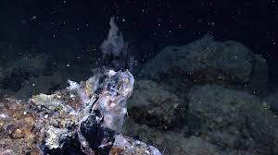
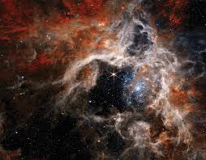
SOLUTION
Solution for first and second problem: However, even on Earth, there are also organisms that can use chemicals as source of energy and this process is called chemosynthesis. Some models of chemosynthesis can be used for adapting seeds and organisms to climate change on Earth and for extraterrestrial populations.
Solution for third problem: Chemosynthesis tends to show us that sometimes life can occur in absence of sunlight and even of oxygen. Here comes our general formula to detect habitable exoplanets in the galaxies, based on the primary principles of chemistry, physics and chemosynthesis and they are discussed here.

Slide 4
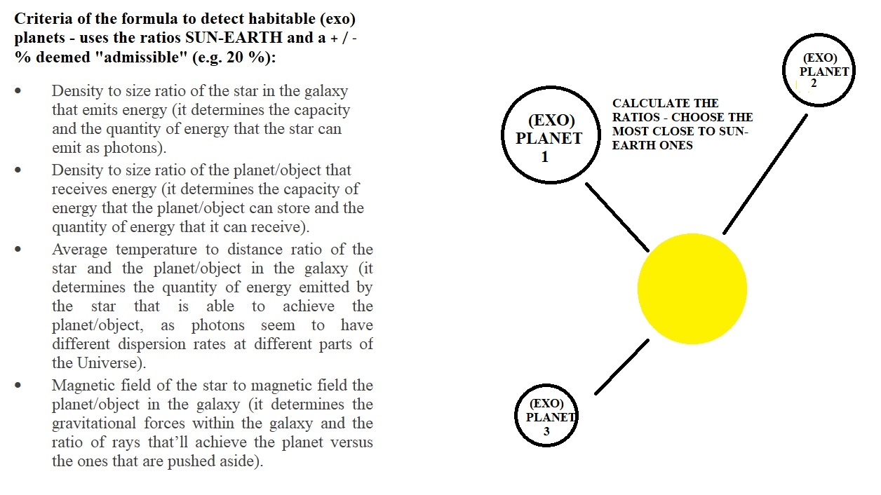
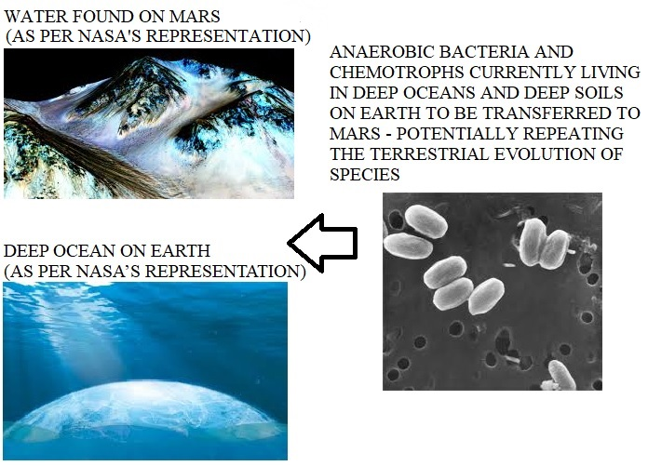
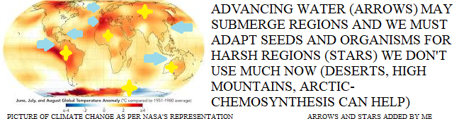
MODELS

Slide 5
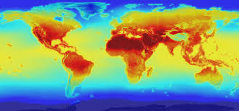
IMPACT AND VALUE FOR KEY STAKEHOLDERS
Impact of our solutions:
Of the models – potential path to adapt to climate change and to populate other planets with organisms apt to survive there.
Of the formula – potential way to discover habitable (exo)planets.
Value for key stakeholders:
For academia – improving understanding of chemosynthesis.
For space agencies – helping in efforts to find habitable (exo)planets.
For climate agencies – adapting agriculture to changing climate.
For the humanity – adapting to climate change and finding places to live in outer space.

Slide 6
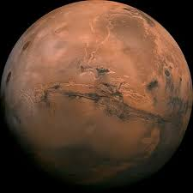
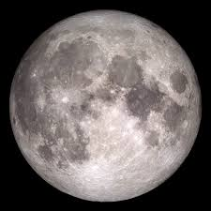
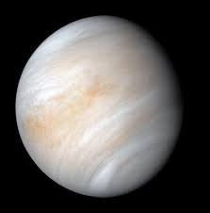
DEPLOYMENT AND TIMELINE
Immediate use of the chemosynthesis models – through the data gathered on anaerobic and chemotroph organisms on Earth can be made models to populate other planets and bring organisms there (most probable focus: Mars and Moon, potentially Venus).
Immediate use of the chemical dependencies discovered to adapt seeds for harsh regions to be used when the climate change destroys agricultural lands.
Immediate use of the formula’s criteria – through the data gathered on characteristics of (exo)planets to distinct those of them which may offer habitable conditions.

Slide 7
THANK YOU FOR YOUR ATTENTION.
REFERENCES:
1. HTTPS://COSPARHQ.CNES.FR/ASSETS/UPLOADS/2021/07/PPPOLICY_2021_3-JUNE.PDF
2. HTTPS://EARTH.ESA.INT/EOGATEWAY/MISSIONS/SMOS/DATA
3. HTTPS://EXOPLANETARCHIVE.IPAC.CALTECH.EDU/
4. HTTPS://NSSDC.GSFC.NASA.GOV/PLANETARY/FACTSHEET/
5. HTTPS://OCEANEXPLORER.NOAA.GOV/EDU/MATERIALS/CHEMOSYNTHESIS-FACT-SHEET.PDF
6. HTTPS://OCEANWORLDS.SPACE/
7. HTTPS://SCIENCE.NASA.GOV/RESOURCE/SOLAR-SYSTEM-TEMPERATURES/
8. HTTPS://WWW.ASC-CSA.GC.CA/ENG/SCIENCES/APEX.ASP
9. HTTPS://WWW.NASA.GOV/SPECIALS/OCEAN-WORLDS/
10. HTTPS://WWW.NASA.GOV/WP-CONTENT/UPLOADS/2015/01/YOSS_ACT1.PDF?EMRC=8A0290
11. HTTPS://WWW.NCEI.NOAA.GOV/PRODUCTS/WORLD-OCEAN-ATLAS
Note: Only pictures from NASA’s official website are used for the models.
CONTACTS: DR. STOYNA WAHDAT
STOYNAWAHDAT@ABV.BG , 00359 886 52 30 87.

